Slide 1
Active Learning Enabled Activity Recognition
H M Sajjad Hossain, Nirmalya Roy, Md Abdullah Al Haﬁz Khan Department of Information Systems, University of Maryland Baltimore County
Chen Shang csh039@latech.edu

Slide 2
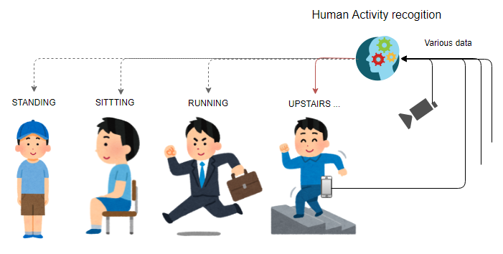
BackGround-Activity Recognition

Slide 3

BackGround-Active Learning

Slide 4
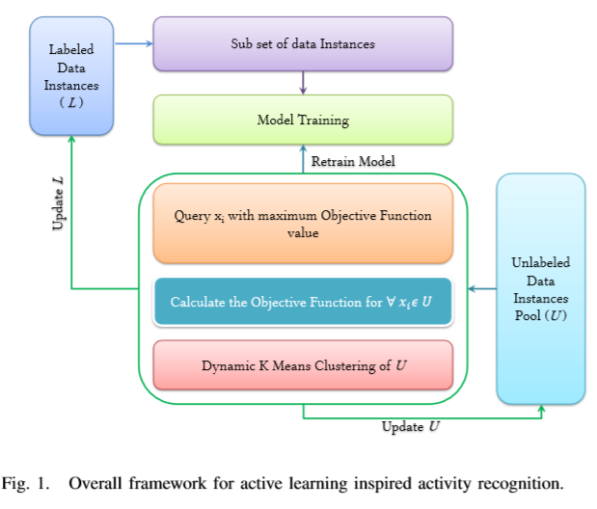
Algorithms

Slide 5
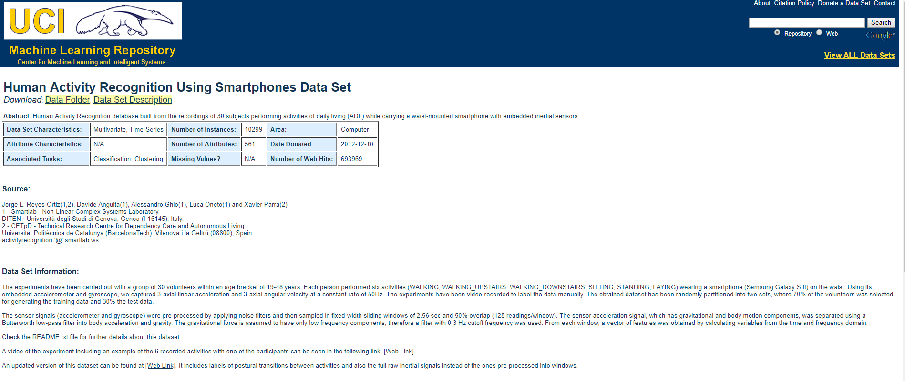
Data
Paper:
They collected data from 10 participants who reside in a retirement community [32] - IRB (#HP-00064387). Each participant provided around 24 hours of continuous sensor data. Average age of the participants was 85.
Our data:
https://archive.ics.uci.edu/ml/datasets/Human+Activity+Recognition+Using+Smartphones

Slide 6
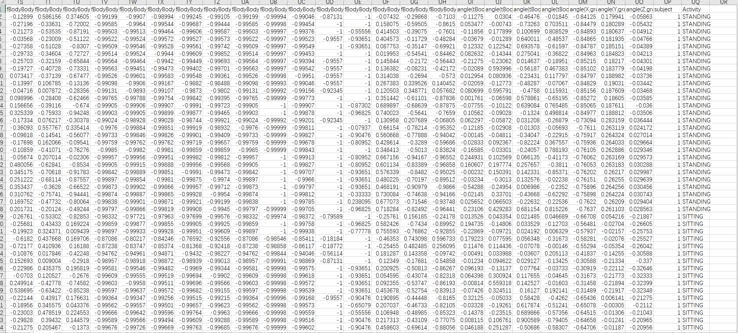
KDD

Slide 7
Target
• They propose to use active learning to alleviate the labeling effort and ground truth data collection in activity recognition pipeline.
• They investigate and analyze different active learning strategies to scale activity recognition and propose a dynamic k-means clustering based active learning approach.

Slide 8
Challenge
• To compare efficiency of this method and other methods.
Or
• To recognize the action from videos or pictures.

